Slide 1
Kinetic Measurement of Leukemia-Cell Proliferation Rate by Deuterium Labeling Predicts Time to Initial Treatment
Abstract 829
Murphy EJ, Neuberg D, Rai KR, Rassenti L, Emson C, Li K, Kay NE, Wierda WG, Hayes GM, Brown JR, Byrd JC, McConnel C, Barrientos JC, Redd RA, Turner S, Busch R, Greaves A, Hellerstein M, Chiorazzi N, Kipps TJ
Notes:
With respect to disclosure, this study was funded entirely by the NIH with an SBIR grant to KineMed. And also through the support of the NIH funded CLL Research Consorium. This study started when I was an employee at Kinemed but I have not been an employee or consultant for there for over 5 years.

Slide 2
Cell Kinetics in CLL
Traditionally thought of as a disease of failed cell death
On average, birth rate of CLL cells < birth normal B cells
It has also been shown that
Significant heterogeneity of birth rates between patients
Some individuals have significantly higher birth rates than normal B cells
Different clones have significantly different birth rates
It is likely that defects in both cell production and destruction are present in CLL
Murphy EK, et al. Blood. 2014;124: Abstract 829.
Notes:
DeFoiche and Van Gent (first authros) (several european groups)

Slide 3
CLL Cell Birth Rate as a Prognostic Marker
Hypothesis: birth rate could be used as a prognostic marker for disease progression in CLL
Study goals:
Assess CLL cell birth rates in untreated patients (Rai stage 0, 1, 2; diagnosis within 3 years)
Compare birth rate to other established prognostic markers
Assess all markers as predictors need for treatment (progression) during 2 years of patient follow-up
Murphy EK, et al. Blood. 2014;124: Abstract 829.
Notes:
Immunolglobulin heavy chain variable region mutation status
IWCLL/NCI riteria International work group and NCI

Slide 4
Demographics
 | Total n = 97
Sex
Female | 39 (40%)
Male | 58 (60%)
Age
Median (range) | 57 (40-85)
Rai stage at enrollment
0 | 36 (37%)
I | 44 (45%)
II | 17 (18%)
Enrollment site
Dana-Farber Cancer Institute | 5 (5%)
North Shore - Long Island Jewish Health System | 19 (20%)
Mayo Clinic | 18 (19%)
MD Anderson Cancer Center | 14 (14%)
Ohio State University | 10 (10%)
University of California San Diego | 31 (32%)
Months from CLL diagnosis to study entry
Median (range) | 12 (1-36)
Murphy EK, et al. Blood. 2014;124: Abstract 829.
Notes:
Male/female

Slide 5
Measurement of CLL Cell Birth Rate Heavy Water Study Protocol
Baseline blood draw; start ²H₂O
= Blood draw
= Saliva sample
stop ²H₂O
Clinical follow-up
0
2
3
4
6
9
12
16
42
68
94
120
²H₂O
Weeks of Study
(50mL TID for first 5d; 60mL daily for 37d)
Murphy EK, et al. Blood. 2014;124: Abstract 829.
Notes:
We measure CLL cell birth rate with stable isotope labeling with deuterated water. Deuterium is a stable, non-radioactive isotope that patients take orally.

Slide 6
Heavy Water Studies Body Water Enrichment and CLL cell incorporation
1.20%
0.040%
0.035%
1.00%
0.030%
0.80%
0.025%
²H Body Water Enrichment
²H Enrichment in DNA
0.60%
0.020%
0.015%
0.40%
0.010%
0.20%
0.005%
0.00%
0.000%
0
5
10
15
20
Weeks
Murphy EK, et al. Blood. 2014;124: Abstract 829.
Notes:
We had 119 subjects enrolled,

Slide 7
CLL Cell Birth Rates (n = 97)
Median Birth Rate 0.32% new cells per day
Range 0/07%-1.31% per day
1.5 –
1.0 –
0.5 –
0.0 –
Treated
Untreated
% New Cells Per Day
Murphy EK, et al. Blood. 2014;124: Abstract 829.
Notes:
An almost 20 fold range in birth rates.

Slide 8
Birth Rate in Relation to Other Prognostic Factors
IGHV Mutation Status
ZAP-70 Expression
CD38 Expression
Cytogenetics
Murphy EK, et al. Blood. 2014;124: Abstract 829.
Notes:
Two sided Wilcoxon rank sum test

Slide 9
Treated Patients
 |  | Treated CLL
 | Total n = 97 | No n = 64 | Yes n = 33
Sex
Female | 39 (40%) | 26 (41%) | 13 (39%)
Male | 58 (60%) | 38 (59%) | 20 (61%)
Age
Median (range) | 57 (40-85) | 58 (40-85) | 56 (41-78)
Rai stage at enrollment
0 | 36 (37%) | 32 (50%) | 4 (12%)
I | 44 (45%) | 24 (38%) | 20 (61%)
II | 17 (18%) | 8 (12%) | 9 (27%)
Enrollment site
Dana-Farber Cancer Institute | 5 (5%) | 3 (5%) | 2 (6%)
North Shore - Long Island Jewish Health System | 19 (20%) | 11 (17%) | 8 (24%)
Mayo Clinic | 18 (19%) | 12 (19%) | 6 (18%)
MD Anderson Cancer Center | 14 (14%) | 9 (14%) | 5 (15%)
Ohio State University | 10 (10%) | 0 (14%) | 1 (3%)
University of California San Diego | 31 (32%) | 20 (31%) | 11 (33%)
Months from CLL diagnosis to study entry
Median (range) | 12 (1-36) | 11 (1-36) | 12 (1-36)
Murphy EK, et al. Blood. 2014;124: Abstract 829.
Notes:
During a median f/u of 4 years, we had 33 patients (34%) receive treatment.

Slide 10
Birth Rate vsTime to Initial Therapy
Birth Rate >0.35% per day ¹
Birth Rate >0.49% per day
1 –
0.8 –
0.6 –
0.4 –
0.2 –
0.0 –
P<.00
1 –
0.8 –
0.6 –
0.4 –
0.2 –
0.0 –
P<.001
≤0.35%
≤0.49%
TTT Probability
TTT Probability
>0.35%
>0.49%
0 1 2 3 4 5 6 7
0 1 2 3 4 5 6 7
Years
Years
Number at risk
≤0.35% 54 50 45 38 23 14 8
>0.35% 43 32 26 22 10 4
Number at risk
≤0.49% 70 70 62 53 29 17 8
>0.49% 20 12 9 7 4 1
1. Messmer BT, et al. J Clin Invest. 2005;115(3):755-764.
Murphy EK, et al. Blood. 2014;124: Abstract 829.
Notes:
Through recursive partitioning and the regression tree method, we determined an optimal cut-point with this data set.
Here’s a kaplan meier curve showing the probabiliyt of treatment.

Slide 11
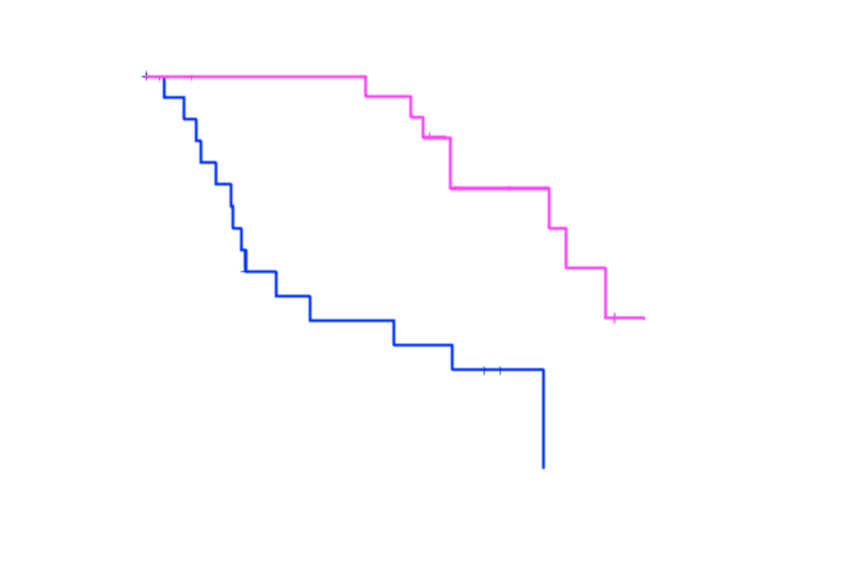
Time to Treatment Stratified by IGHV and Birth Rate
1.0 –
0.8 –
0.6 –
0.4 –
0.2 –
0.0 –
Slow, mutated
Fast, mutated
TTT Probability
Slow, unmutated
Fast, unmutated
0 1 2 3 4 5 6 7
Years
Murphy EK, et al. Blood. 2014;124: Abstract 829.

Slide 12
Conclusions
Increased CLL cell birth rate in early-stage disease is a strong predictor of earlier treatment
In a multivariable model, only birth rate and IGHV mutational status contributed significantly
Within the groups of patients with mutated or unmutated IGHV, birth rate allowed further discrimination in a time-to-treatment analysis
This direct measure of CLL-cell proliferation represents a new marker for prognostication for subjects with early-stage CLL
Murphy EK, et al. Blood. 2014;124: Abstract 829.

